Slide 1


Customer Segmentation - ANZ credit card
Mini Project 3
Len Kwok

Slide 2



One of the key pain points for marketers is to know their customers and identify their needs.
By understanding the customer, marketers such as ANZ credit card can launch a targeted marketing campaign that is tailored for specific needs.
If data about the customers is available, we can group customers based on their spending behaviour.

Slide 3



Business Question
Bank wants targeted ad marketing campaign for existing 8,600 customers.
Data Question
How can we divide (segment) customers into distinctive groups?
Stakeholders: Marketing department, senior managers, data scientists, customers.

Slide 4
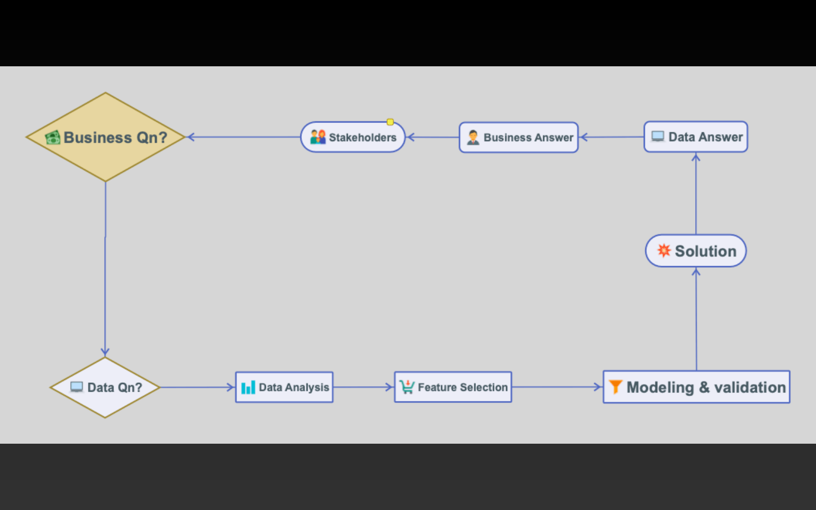

Project Pipeline

Slide 5


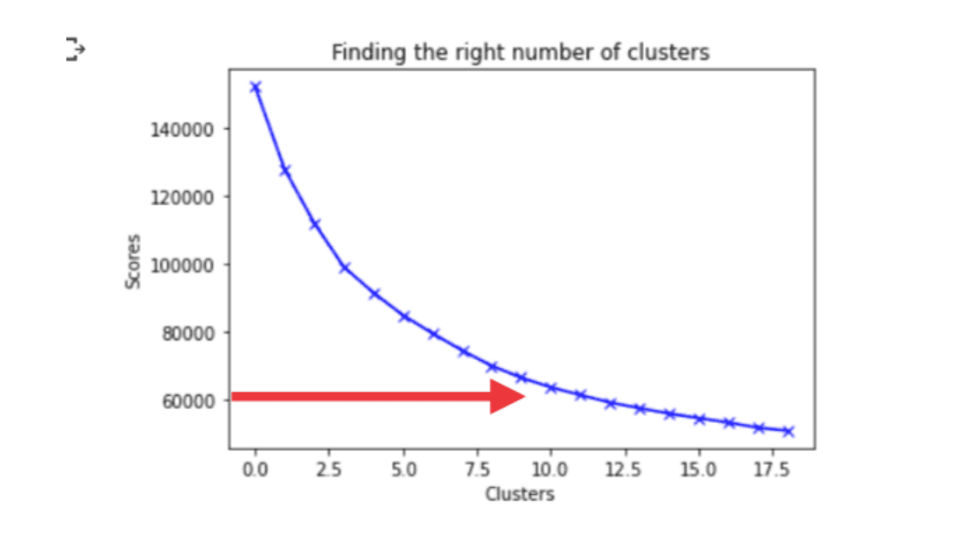
Find Optimal Number of Clusters
Elbow Method

Slide 6

K-Means Algorithm
Having identified 8 clusters, we can stop now and export to Excel for analysis....
Features
Cust 1
Cust 2
Cust 3
Cust 4
Cust 5
1
BALANCE
40.900749
3202.467416
2495.148862
1666.670542
817.714335
2
BALANCE_FREQUENCY
0.818182
0.909091
1
0.636364
1
3
PURCHASES
95.4
0
773.17
1499
16
4
ONEOFF_PURCHASES
0
0
773.17
1499
16
5
INSTALLMENTS_PURCHASES
95.4
0
0
0
0
6
CASH_ADVANCE
0
6442.945483
0
205.788017
0
7
PURCHASES_FREQUENCY
0.166667
0
1
0.083333
0.083333
8
ONEOFF_PURCHASES_FREQUENCY
0
0
1
0.083333
0.083333
9
PURCHASES_INSTALLMENTS_FREQUENCY
0.083333
0
0
0
0
10
CASH_ADVANCE_FREQUENCY
0
0.25
0
0.083333
0
11
CASH_ADVANCE_TRX
0
4
0
1
0
12
PURCHASES_TRX
2
0
12
1
1
13
CREDIT_LIMIT
1000
7000
7500
7500
1200
14
PAYMENTS
201.802084
4103.032597
622.066742
0
678.334763
15
MINIMUM_PAYMENTS
139.509787
1072.340217
627.284787
864.206542
244.791237
16
PRC_FULL_PAYMENT
0
0.222222
0
0
0
17
TENURE
12
12
12
12
12
cluster
5
2
6
5
5

Slide 7



Curse of Dimensionality
Sometimes excessive features lead to overfitting. Also, bad for eyesight 👓
Click https://pxlme.me/Ux-msg1lto see sorted spreadsheet of all values.
Click here for summary of clusters https://pxlme.me/wjYpYsbN

Slide 8

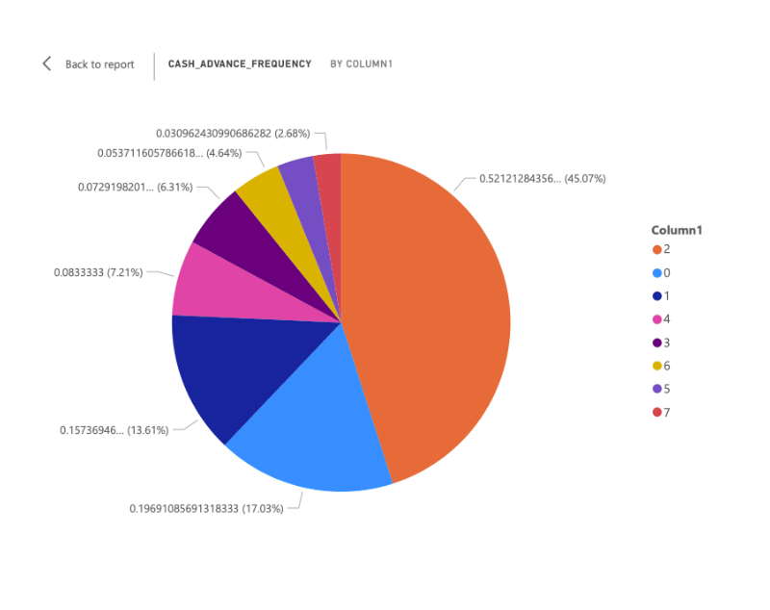
Power BI
A few clicks for cluster analysis

Slide 9

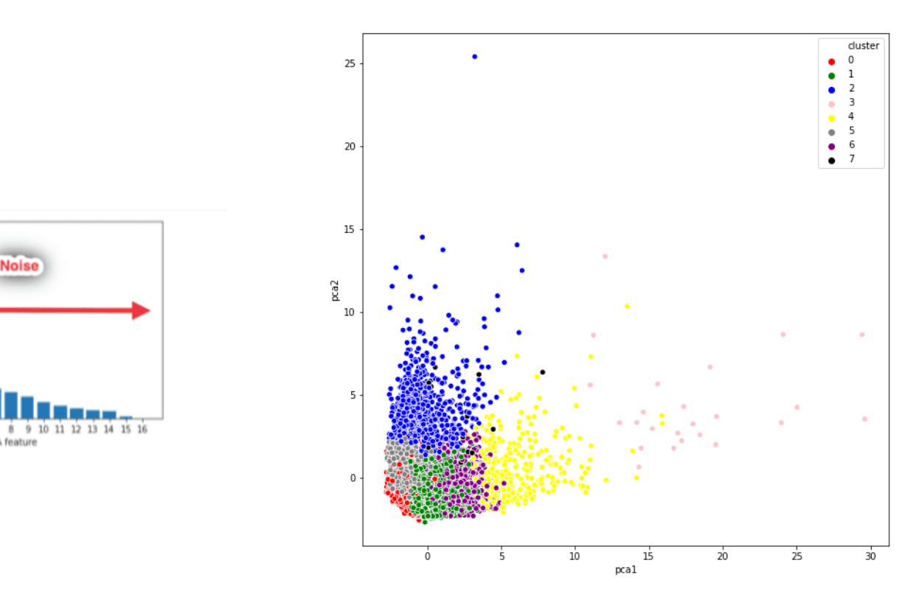
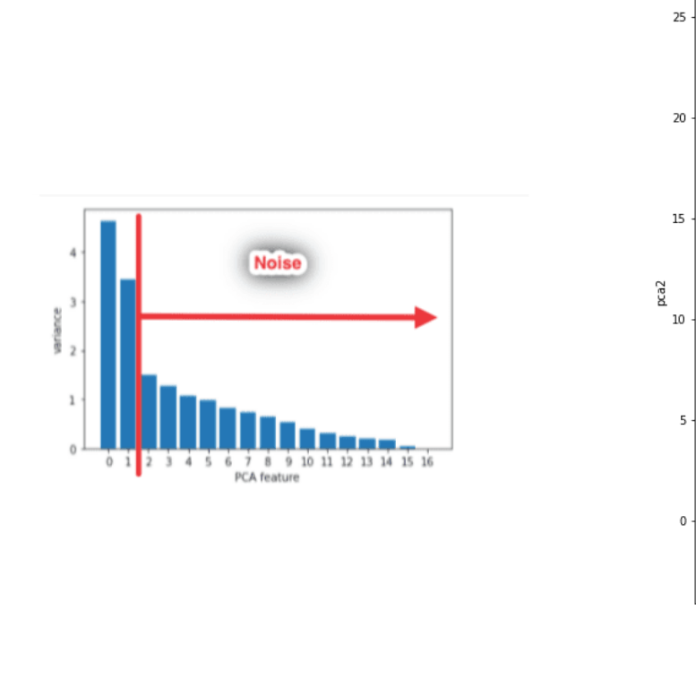
Principal Component Analysis (PCA)
Keep original information, reduced features from 17 to only 2.

Slide 10

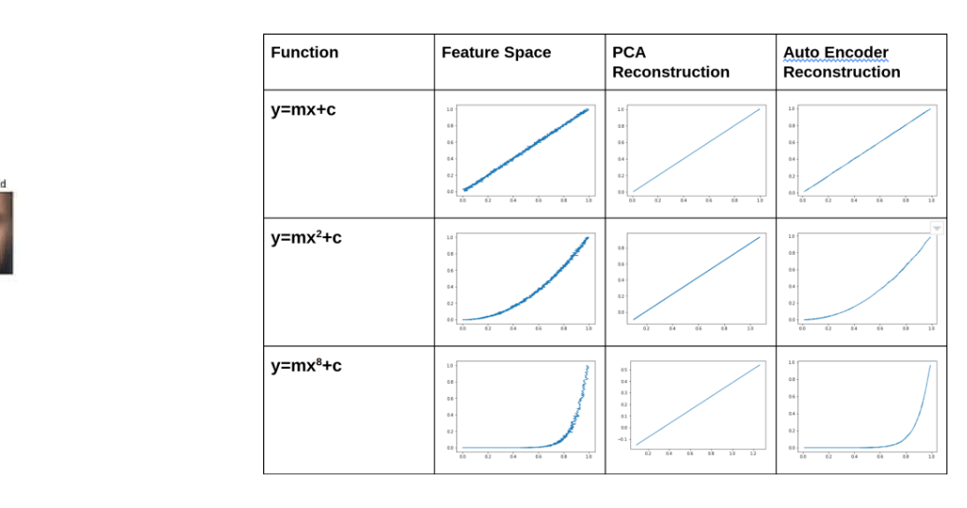
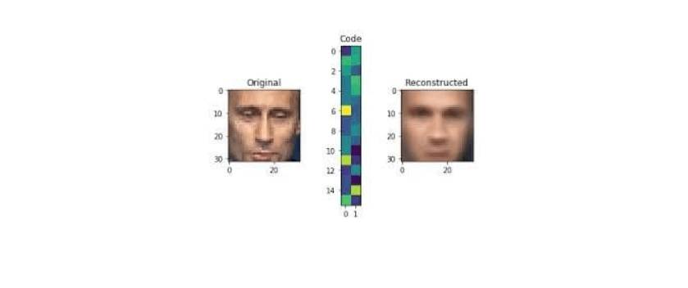
What are autoencoders?
CNN, image compression, noise removal.
https://www.jeremyjordan.me/autoencoders/

Slide 11

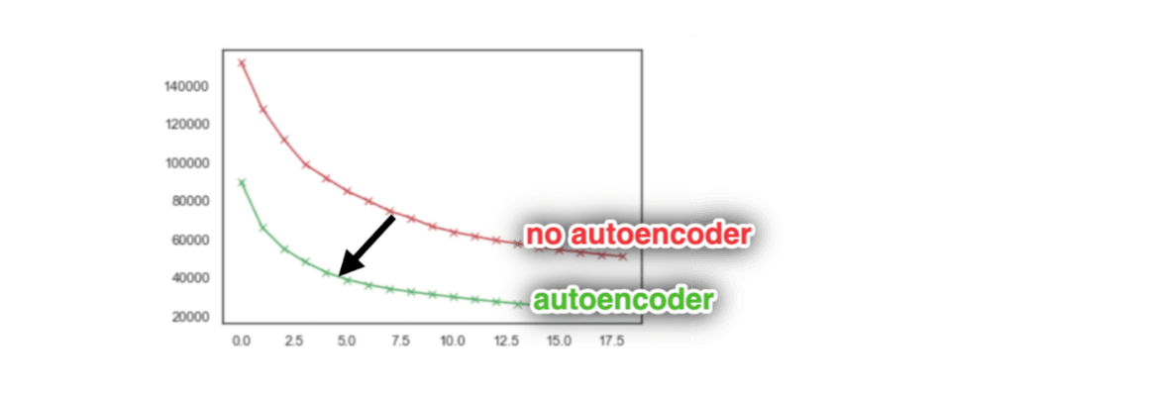

Repeat Elbow Method
Cluster Numbers from 8 to 4
Would lesser cluster numbers improve customer segmentation? Let's run K-Means again.

Slide 12

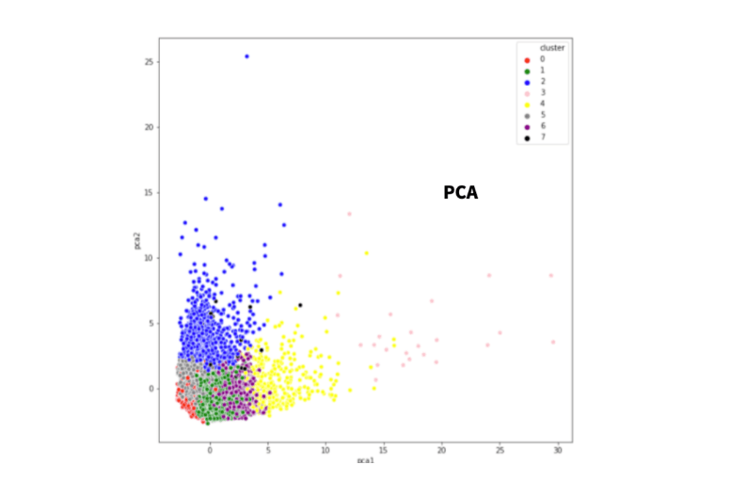
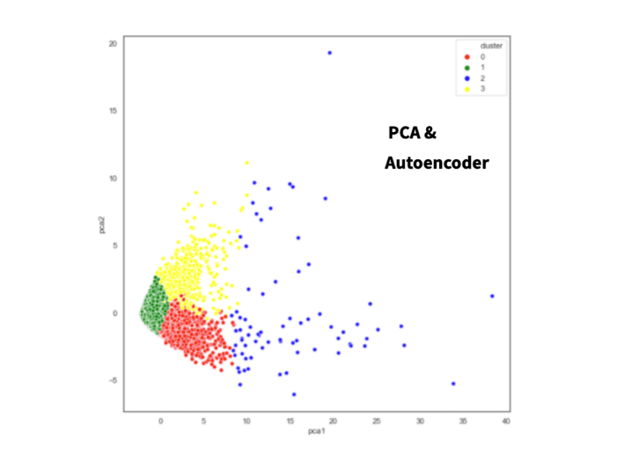
PCA vs Autoencoder
Simplified Customer Segmentation

Slide 13


Future Steps
Find out what PCA1 and PCA 2 mean by inverse-transform.
Further analysis using Power BI for 2 clusters.

Slide 14


Thank you for listening!

